Slide 1
British Airways
Customer ratings analysis and insights
2022-11-09

Slide 2
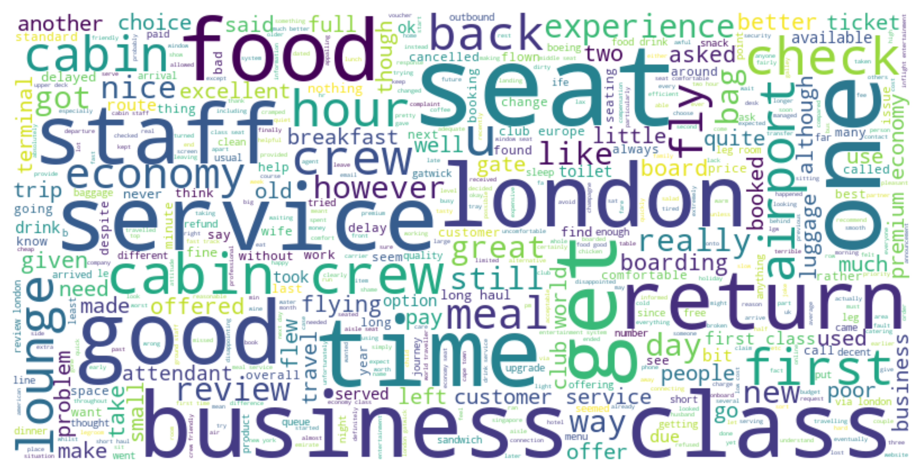
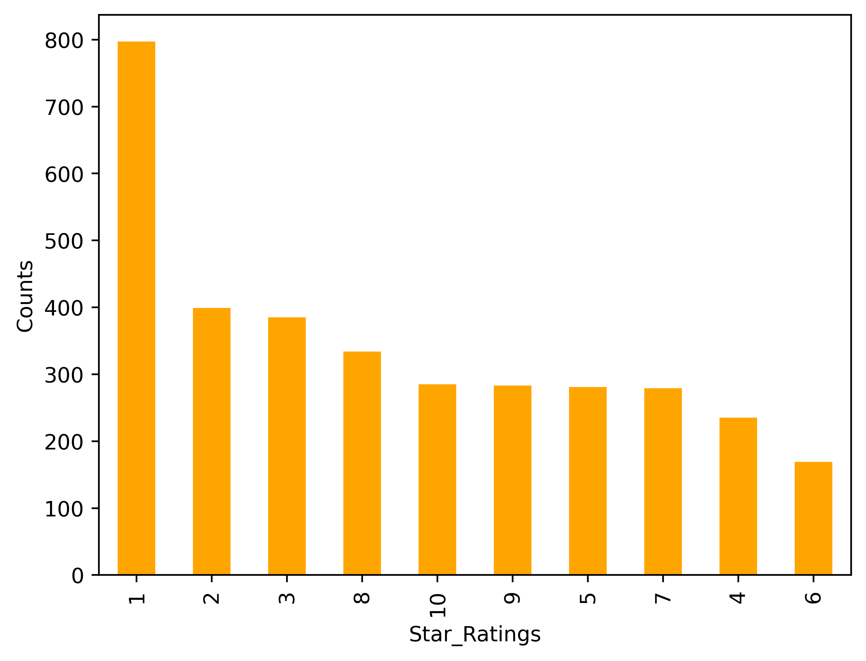
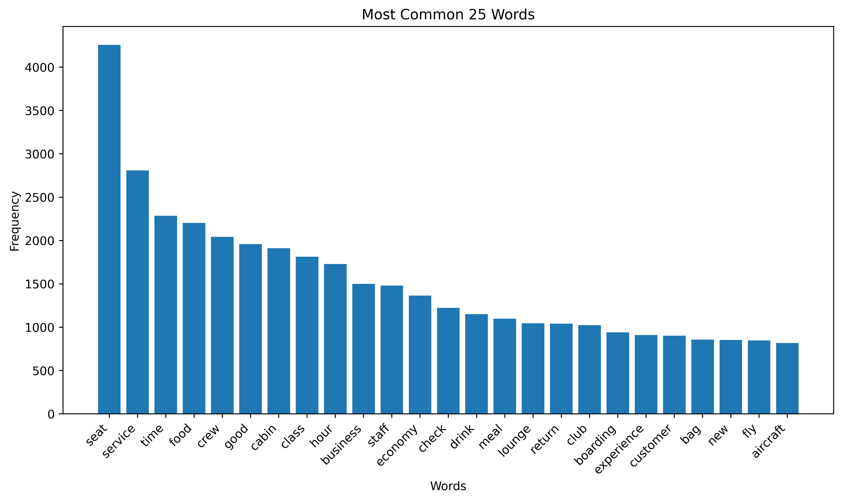
primary measurements
Star Rating : 4.68/10
3447 reviews
Reviews for 1-4 star ratings : customer service
Reviews for 5-6 star ratings : flight delayed
Reviews for 7-10 star ratings : cabin crew
There are some positive reviews about cabin crew such as friendly attentive, helpful and efficient friendly.
Based on the reviews, we can say that the number of customers using business class is high
Negative reviews are about customer service and it is required to improve

